Slide 1
Database Management Systems Sessional(CSE 2206) Project name:Hotel Management System
Bangladesh Army University of Science and Technology
Department of Computer Science and Engineering
Group Members: 1.Mousumi Monera Khatun (210201014) 2.Abir Hasan Imran (210201028) 3.Rayhan Sarkar Roman (210201036) 4.Fatema Tuj Zohora (210201039) | Project Supervisor: Hasan Muhammad Kafi Assistant professor Department of Computer Science and Engineering, BAUST

Slide 2
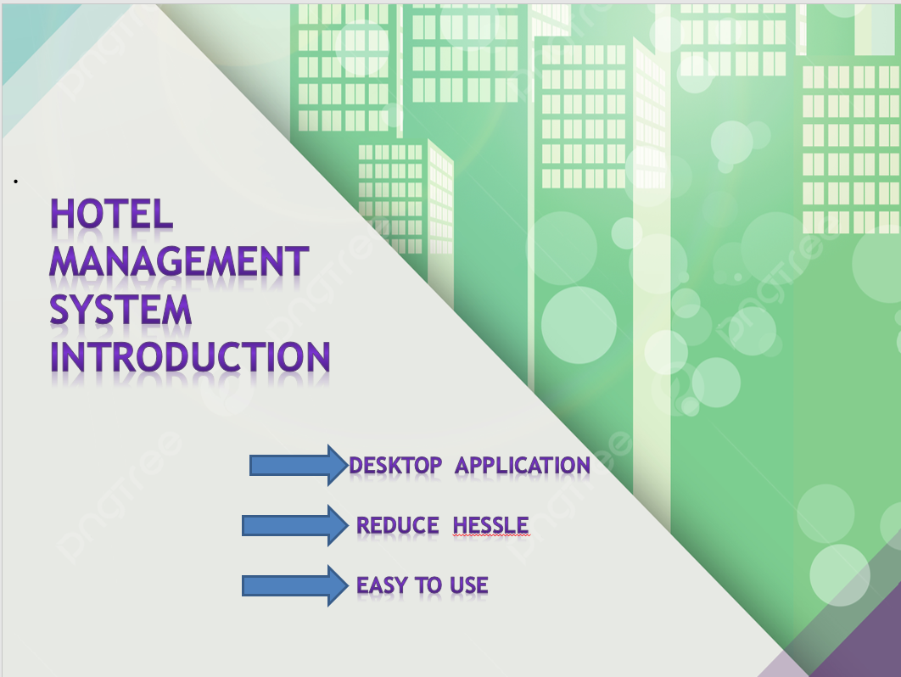

Slide 3
Objectives
Using My SQL Database to store data.
A option for customer to book hotel.
Better system to store current employee information.

Slide 4
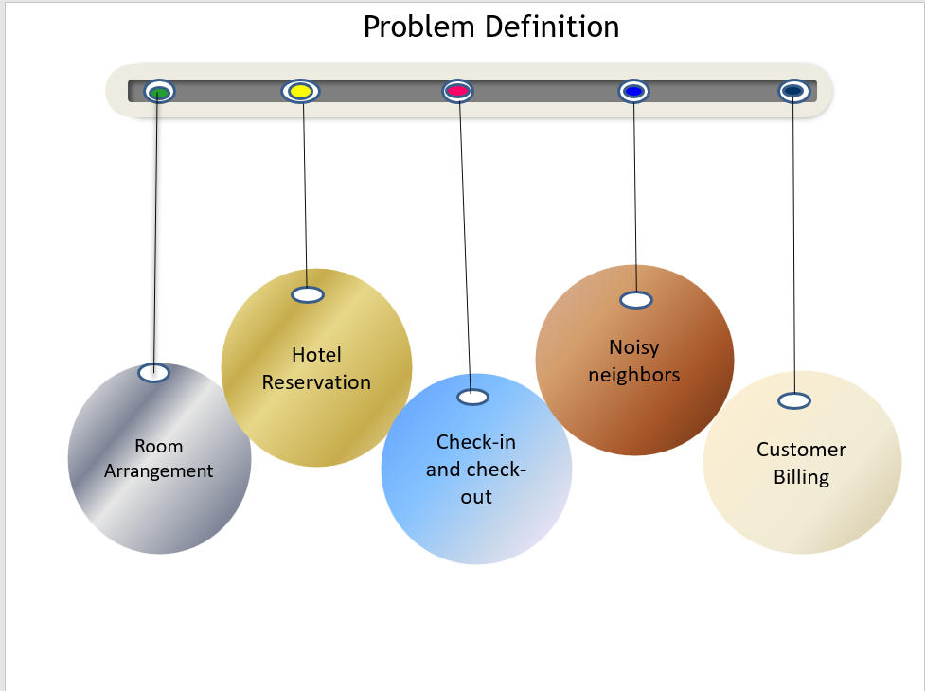

Slide 5
Methodology
Collect require data
Creating database
Implementation
Testing
Deployment

Slide 6
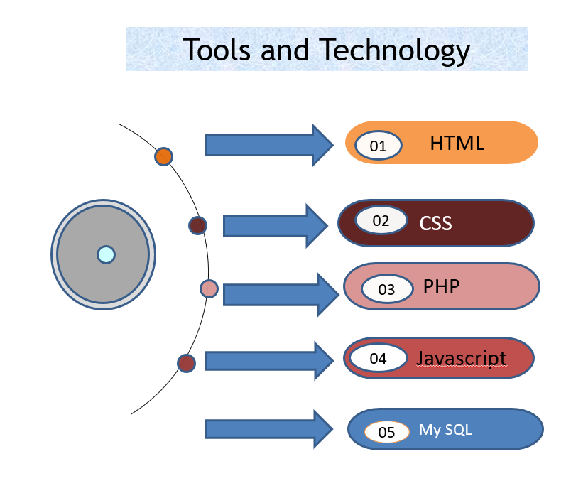

Slide 7
Case study of old system
Goals of the new system
Physically attend need to book room.
Customer calls to manager for review.
Hard to are range in ledger.
Hard to know who is current employee.
Need to do big calculation manually
Review about hotel.
Managers manages room digitally.
Admins can see earning information.
Book Hotel from home.

Slide 8
Benefits of this projects:
Streamlined Operations
Enhance Guest Experience
Improved communication
Better Financial management

Slide 9
Conclusion: The Conclusion of this project is a hotel management system is a computerized management systems. This system keeps the records of hardware assets besides software of the organization. The proposed system will keep a track of workers, residents,accounts generation of report regarding the present status.

Slide 10


